Slide 1



Futurion
Data Analysis
UPSKILLING INDIA
Portfoliio Project Challenge
Lung Cancer Anaylsis
By-Vishakha jaiswal
Submission Deadline: 21/02/2024
Tools use- SQL , Excel and Power Bi
01

Slide 2

Futurion
UPSKILLING INDIA
📌Problem Statement:
Lung cancer is one of the leading causes of cancer-related deaths worldwide. Early detection and understanding risk factors such as smoking habits, gender-based impact, and environmental exposure can help improve survival rates and treatment strategies. This analysis aims to identify key trends, risk factors, and patient demographics to support healthcare professionals in decision-making.
🎯 Objectives
1️⃣ Assess Smoking Impact – Analyze the effect of smoking habits on lung cancer cases.
2️⃣ Early Detection & Stages – Study detection rates and cancer stage distribution.
3️⃣ Gender-Based Analysis – Compare lung cancer cases and passive smoking effects by gender.
4️⃣ Survival & Mortality Rates – Evaluate survival trends based on stages and treatments.
5️⃣ Environmental Factors – Examine air pollution and lifestyle impacts on lung cancer.
03

Slide 3
Futurion
Instructions
UPSKILLING INDIA
📊 Dataset Overview
Number of records : 2206332
Number of Columns : 24
Data Cleaning:
Null (None)Value:
Categorized smoking impact – Created a metric based on years of smoking and cigarettes per day
Perform Dax Query
03

Slide 4
Futurion
UPSKILLING INDIA
SQL Queries
04

Slide 5
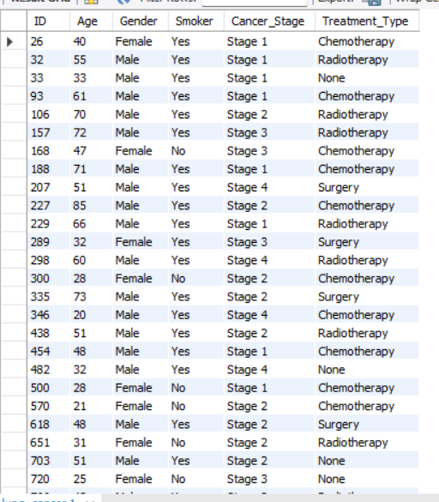

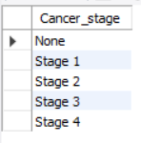

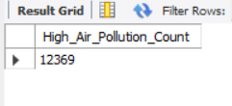
Futurion
Basic Queries
UPSKILLING INDIA
1. Retrieve all records for individuals diagnosed with lung cancer.
SELECT ID, Age, Gender, Smoker, Cancer_Stage, Treatment_Type
FROM lung_cancer WHERE Lung_Cancer_Diagnosis = 'Yes';
2. Count the number of smokers and non-smokers.
SELECT
SUM(CASE WHEN Passive_Smoker = 'Yes' THEN 1 ELSE 0 END) AS Smokers,
SUM(CASE WHEN Passive_Smoker = 'No' THEN 1 ELSE 0 END) AS Non_SmokersFROM lung_cancer;
3. List all unique cancer stages present in the dataset.
SELECT distinct(Cancer_stage)
from lung_cancer;
4. Retrieve the average number of cigarettes smoked per day by smokers.
Select avg(Cigarettes_per_Day) as avg_cigratte_per_day
from lung_cancer;
5. Count the number of people exposed to high air pollution.
SELECT COUNT(*) AS High_Air_Pollution_Count
FROM lung_cancer
WHERE Air_Pollution_Exposure = 'High';
05

Slide 6
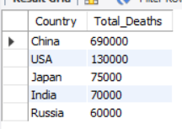
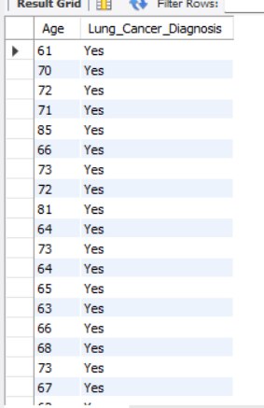

Futurion
UPSKILLING INDIA
6. Find the top 5 countries with the highest lung cancer deaths.
SELECT Country, MAX(Annual_Lung_Cancer_Deaths) AS Total_Deaths
FROM lung_cancer
GROUP BY Country
ORDER BY Total_Deaths DESCLIMIT 5;
7. Count the number of people diagnosed with lung cancer by gender.
SELECT Gender, COUNT(*) AS Lung_Cancer_Count
FROM lung_cancer
WHERE Lung_Cancer_Diagnosis = 'Yes'GROUP BY Gender;
8. Retrieve records of individuals older than 60 who are diagnosed with lung cancer.
SELECT Age , Lung_Cancer_Diagnosis
FROM lung_cancerWHERE Age > 60 AND Lung_Cancer_Diagnosis = 'Yes';
Intermediate Level
—
1. Find the percentage of smokers who developed lung cancer.
SELECT
COUNT(CASE WHEN Lung_Cancer_Diagnosis = 'Yes' THEN 1 END) * 100.0 / COUNT(*)) AS Percentage_Smokers_With_Lung_Cancer
FROM lung_cancerWHERE Smoker = 'Yes';
04

Slide 7
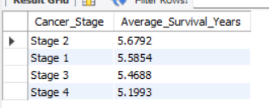
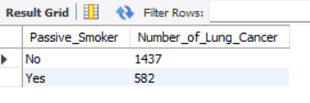

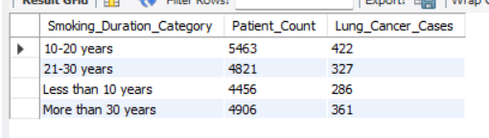
Futurion
UPSKILLING INDIA
2. Calculate the average survival years based on cancer stages.
SELECT Cancer_Stage, AVG(Survival_Years) AS Average_Survival_Years
FROM lung_cancerWHERE Lung_Cancer_Diagnosis = 'Yes’
GROUP BY Cancer_Stage
ORDER BY Average_Survival_Years DESC;
3. Count the number of lung cancer patients based on passive smoking.
SELECT Passive_Smoker, COUNT(CASE WHEN Lung_Cancer_Diagnosis = 'Yes' THEN 1 END) AS Number_of_Lung_Cancer
FROM lung_cancer
GROUP BY Passive_Smoker;
4. Find the country with the highest lung cancer prevalence rate.
SELECT Country, Lung_Cancer_Prevalence_Ratefrom lung_cancer
order by Lung_Cancer_Prevalence_Rate desc
limit 1;
5. Identify the smoking years' impact on lung cancer.
SELECT
CASE
WHEN Years_of_Smoking < 10 THEN 'Less than 10 years'
WHEN Years_of_Smoking BETWEEN 10 AND 20 THEN '10-20 years'
WHEN Years_of_Smoking BETWEEN 21 AND 30 THEN '21-30 years'
ELSE 'More than 30 years' END AS Smoking_Duration_Category,
COUNT(*) AS Patient_Count, COUNT(CASE WHEN Lung_Cancer_Diagnosis = 'Yes' THEN 1 END) AS Lung_Cancer_Cases
FROM lung_cancer
WHERE Smoker = 'Yes'GROUP BY Smoking_Duration_Category
ORDER BY Smoking_Duration_Category;
04

Slide 8
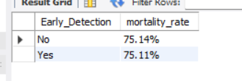

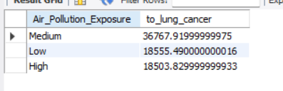
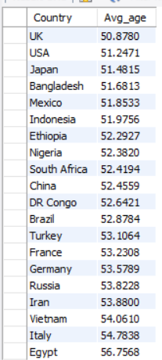
Futurion
UPSKILLING INDIA
6. Determine the mortality rate for patients with and without early detection.
SELECT Early_Detection,
concat(round(avg(Mortality_rate),2),"%") as mortality_rate
from lung_cancer
where Lung_Cancer_Diagnosis = "Yes"
Group by Early_Detection;
7. Group the lung cancer prevalence rate by developed vs. developing countries.
SELECT Developed_or_Developing, COUNT(*) AS Total_Patients,
COUNT(CASE WHEN Lung_Cancer_Diagnosis = 'Yes' THEN 1 END) AS Lung_Cancer_Patients, (COUNT(CASE WHEN Lung_Cancer_Diagnosis = 'Yes' THEN 1 END) * 100.0 / COUNT(*)) AS Prevalence_Rate_Percentage
FROM lung_cancerGROUP BY Developed_or_Developing
ORDER BY Prevalence_Rate_Percentage DESC;
Advanced Level–
Identify the correlation between lung cancer prevalence and air pollution levels.
SELECT Air_Pollution_Exposure, sum(Lung_Cancer_Prevalence_Rate) as to_lung_cancer
FROM lung_cancergroup by Air_Pollution_Exposure
order by to_lung_cancer desc;
2. Find the average age of lung cancer patients for each country.
Select Country, avg(Age) as Avg_age from lung_cancer
WHERE Lung_Cancer_Diagnosis = 'Yes'group by country
order by Avg_age;
04

Slide 9
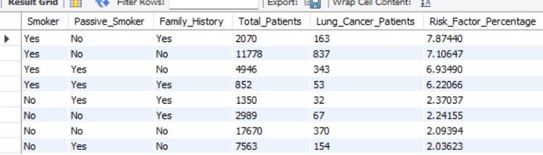
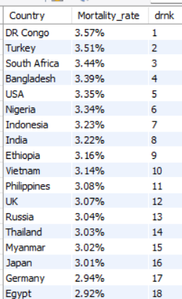
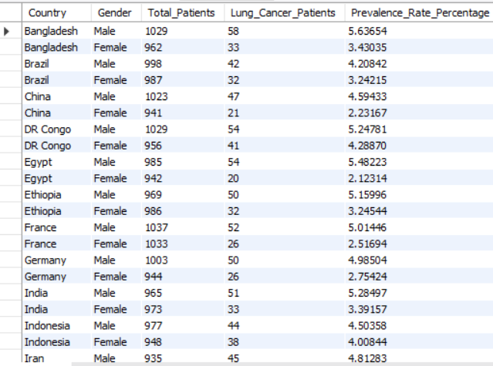
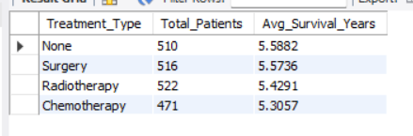
Futurion
UPSKILLING INDIA
3. Calculate the risk factor of lung cancer by smoker status, passive smoking, and family history.
SELECT Smoker, Passive_Smoker, Family_History,
COUNT(*) AS Total_Patients, COUNT(CASE WHEN Lung_Cancer_Diagnosis = 'Yes' THEN 1 END) AS Lung_Cancer_Patients,
(COUNT(CASE WHEN Lung_Cancer_Diagnosis = 'Yes' THEN 1 END) * 100.0 / COUNT(*)) AS Risk_Factor_Percentage
FROM lung_cancer
GROUP BY Smoker, Passive_Smoker, Family_History
ORDER BY Risk_Factor_Percentage DESC;
4. Rank countries based on their mortality rate.
SELECT Country,
CONCAT(ROUND(AVG(mortality_rate), 2), '%') AS Mortality_rate,
DENSE_RANK() OVER (ORDER BY ROUND(AVG(mortality_rate), 2) DESC) AS drnk
FROM lung_cancer
GROUP BY Country;
5. Determine if treatment type has a significant impact on survival years.
SELECT Treatment_Type, COUNT(*) AS Total_Patients, AVG(Survival_Years) AS Avg_Survival_Years
FROM lung_cancer
WHERE Lung_Cancer_Diagnosis = 'Yes’
GROUP BY Treatment_Type
ORDER BY Avg_Survival_Years DESC;
6. Compare lung cancer prevalence in men vs. women across countries.
SELECT Country, Gender, COUNT(*) AS Total_Patients, COUNT(CASE WHEN Lung_Cancer_Diagnosis = 'Yes' THEN 1 END) AS Lung_Cancer_Patients, (COUNT(CASE WHEN Lung_Cancer_Diagnosis = 'Yes' THEN 1 END) * 100.0 / COUNT(*)) AS Prevalence_Rate_Percentage
FROM lung_cancer
GROUP BY Country, Gender
ORDER BY Country, Prevalence_Rate_Percentage DESC;
04

Slide 10
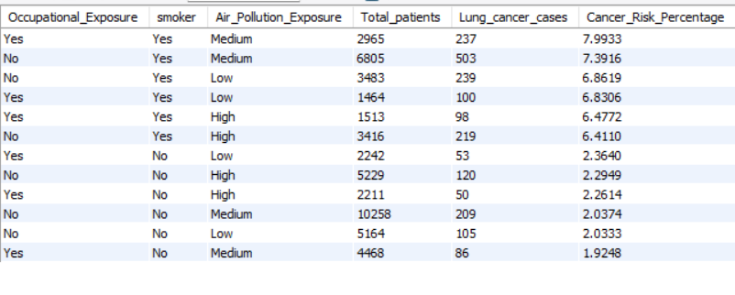

Futurion
UPSKILLING INDIA
7. Find how occupational exposure, smoking, and air pollution collectively impact lung cancer rates.
Select Occupational_Exposure , smoker, Air_Pollution_Exposure,count(*) as Total_patients,
count(Case When Lung_Cancer_Diagnosis = 'Yes' THEN 1 END) as Lung_cancer_cases,
(Count(Case When Lung_Cancer_Diagnosis = 'Yes' THEN 1 END)*100/count(*))as Cancer_Risk_Percentage
from lung_cancer
group by Occupational_Exposure , smoker, Air_Pollution_Exposure
order by Cancer_Risk_Percentage desc;
8. Analyze the impact of early detection on survival years.
Select Early_Detection , Count(*) as Total_patients, avg(Survival_Years) as Avg_Surviaval_years,Min(Survival_Years) as Min_Survival_years,Max(Survival_Years) as max_survival_yearsfrom lung_cancer
Where Lung_Cancer_Diagnosis ='Yes’
Group by Early_Detection
order by Avg_Surviaval_years desc;
04

Slide 11
Futurion
UPSKILLING INDIA
Data Visualization
01

Slide 12
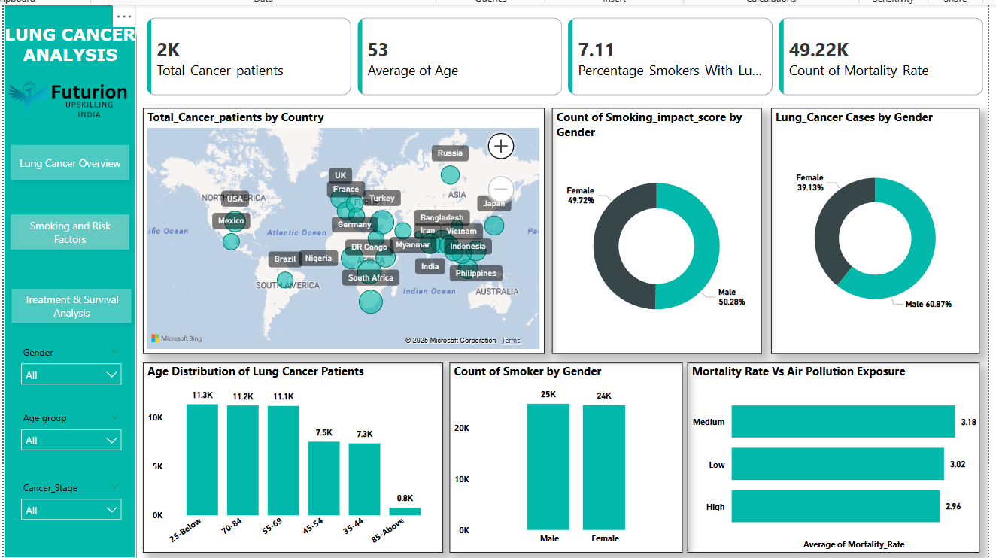
Futurion
Lung Cancer Overview
UPSKILLING INDIA
04

Slide 13
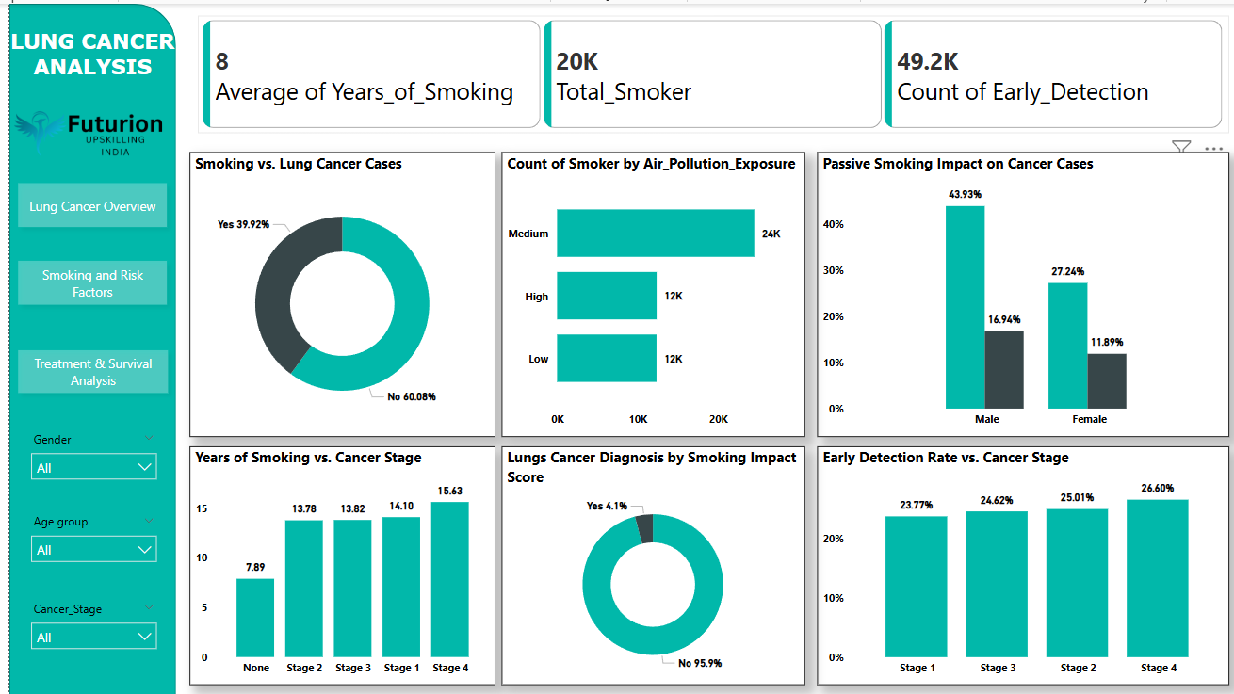
Futurion
Smoking And Risk Factors
UPSKILLING INDIA
04

Slide 14
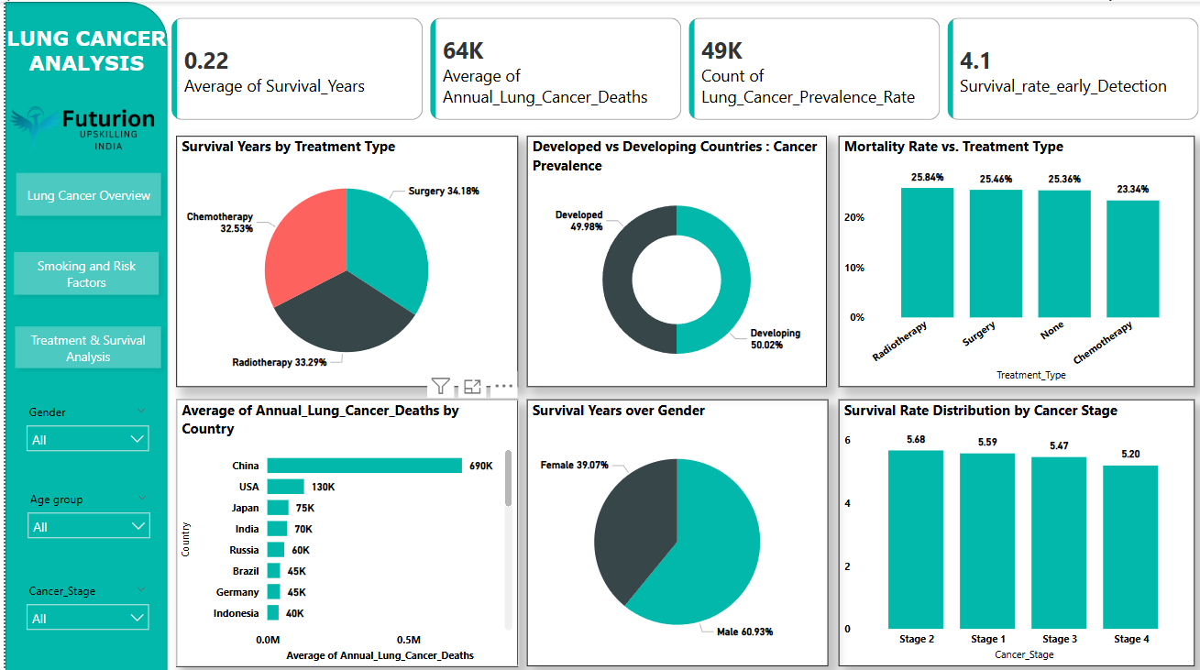

Futurion
Treatment & Survival Analysis
UPSKILLING INDIA
05

Slide 15
Futurion
UPSKILLING INDIA
Insights:
Survival Rate & Treatment Type:
Surgery has the highest survival rate, followed closely by radiotherapy and chemotherapy.
Mortality rates for different treatments are almost similar, but chemotherapy has the lowest mortality rate.
Lung Cancer Prevalence:
Almost equal distribution between developed (49.98%) and developing countries (50.02%).
China, USA, Japan, and India have the highest number of lung cancer deaths.
Gender-based Analysis:
More males (60.93%) survive compared to females (39.13%).
Males also have a higher smoking impact score (50.28% vs. 49.72% for females).
Lung cancer cases are more prevalent in males (60.87%) than in females (39.13%).
Smoking & Air Pollution Impact:
Around 39.92% of lung cancer cases are linked to smoking.
Passive smoking has a higher impact on males (43.93%) compared to females (27.24%).
Higher air pollution exposure leads to an increased mortality rate, but medium exposure has the highest impact.
Age-wise Analysis:
Majority of lung cancer patients are in the 25-below, 70-84, and 55-69 age groups.
The survival rate remains relatively stable across different cancer stages.
Early Detection & Cancer Stages:
Early detection rates increase as cancer progresses from Stage 1 to Stage 4.
Patients with Stage 4 lung cancer had the longest smoking history (15.63 years on average), reinforcing the strong correlation between smoking duration and cancer severity.
Task 02
Normalize or standardize relevant fields (e.g., age, blood counts).
06

Slide 16
Futurion
UPSKILLING INDIA
Recommendations:
Prevention & Awareness Campaigns:
Implement smoking cessation programs, particularly targeting men.
Raise awareness about the impact of passive smoking, especially for females.
Early Detection & Screening:
Encourage lung cancer screening, especially for high-risk groups (smokers and individuals exposed to air pollution).
Strengthen early detection programs as survival rates improve with early diagnosis
Environmental & Policy Actions:
Implement policies to reduce air pollution exposure.
Encourage workplaces and public areas to adopt stronger anti-smoking regulations.
Healthcare Strategy:
Focus on personalized treatment plans based on survival analysis insights.
Promote surgery as an effective treatment while improving access to chemotherapy and radiotherapy.
Further Research & Data Analysis:
Investigate regional disparities in lung cancer prevalence and survival.
Conduct deeper analysis into lifestyle factors beyond smoking that impact lung cancer cases.
07

